Slide 1
Step 16 – CI/CD tool using Jenkin

Slide 2
What is CI and CD tool
Continuous integration and Continuous delivery
Continuous Delivery (CD) is an approach used by teams to release features in short cycles. It aims to accelerate the phase at which the software is built, released, and tested. Continuous delivery tools or continuous deployment tools are related concepts that are sometimes used interchangeably.
Specifically, CI/CD introduces ongoing automation and continuous monitoring throughout the lifecycle of apps, from integration and testing phases to delivery and deployment.

Slide 3
Jenkin
Jenkins is an open-source automation tool written in Java with plugins built for continuous integration.
Jenkins is used to build and test your software projects continuously making it easier for developers to integrate changes to the project, and making it easier for users to obtain a fresh build.
It also allows you to continuously deliver your software by integrating with a large number of testing and deployment technologies.

Slide 4
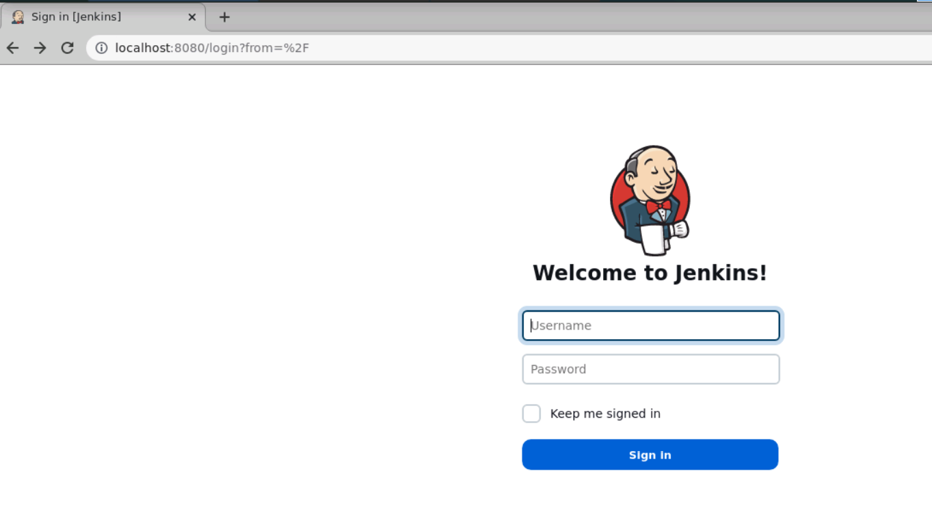
To work with Jenkin please login the virtual lab
And write the URL as http://localhost:8080

Slide 5
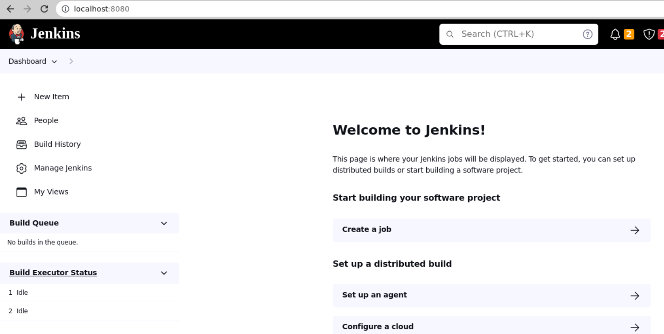
Jenkin username and password in virtual lab is username is root and password is root

Slide 6
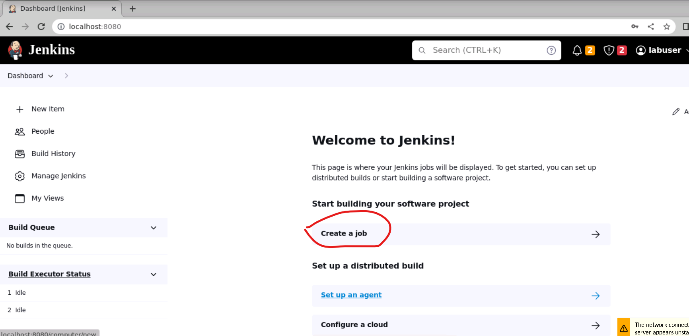
In Jenkin to do any task we need to create the job. So Creating simple job

Slide 7
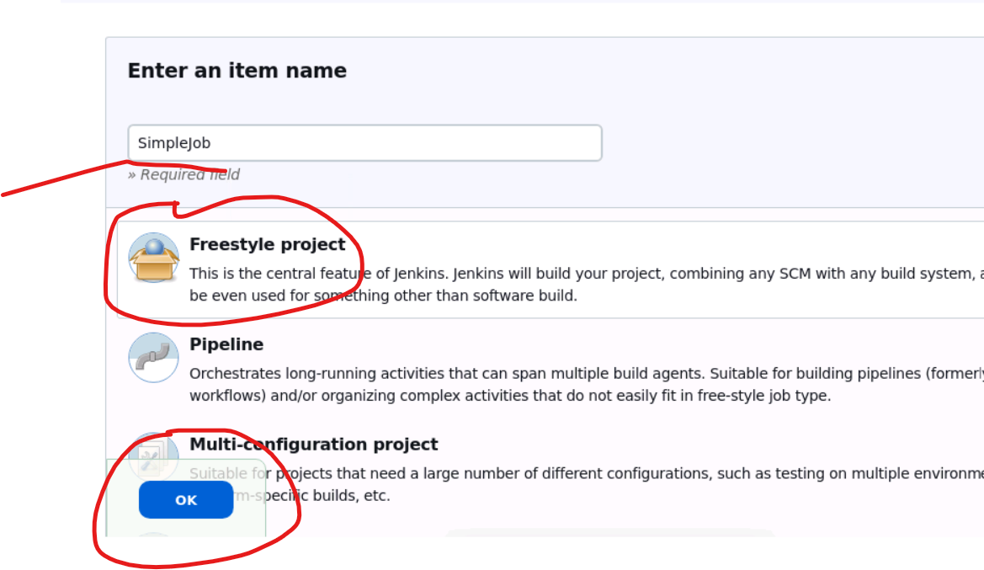
Creating simple job please follow below steps.

Slide 8
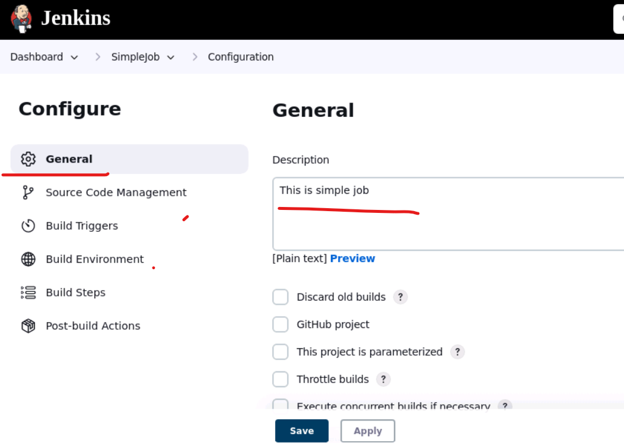
General description

Slide 9
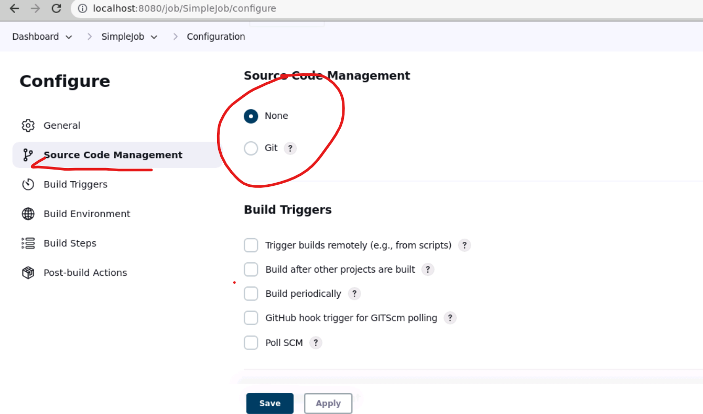
Source code management : if you want to pull any project from git into Jenkin environment then we need to select this option.

Slide 10
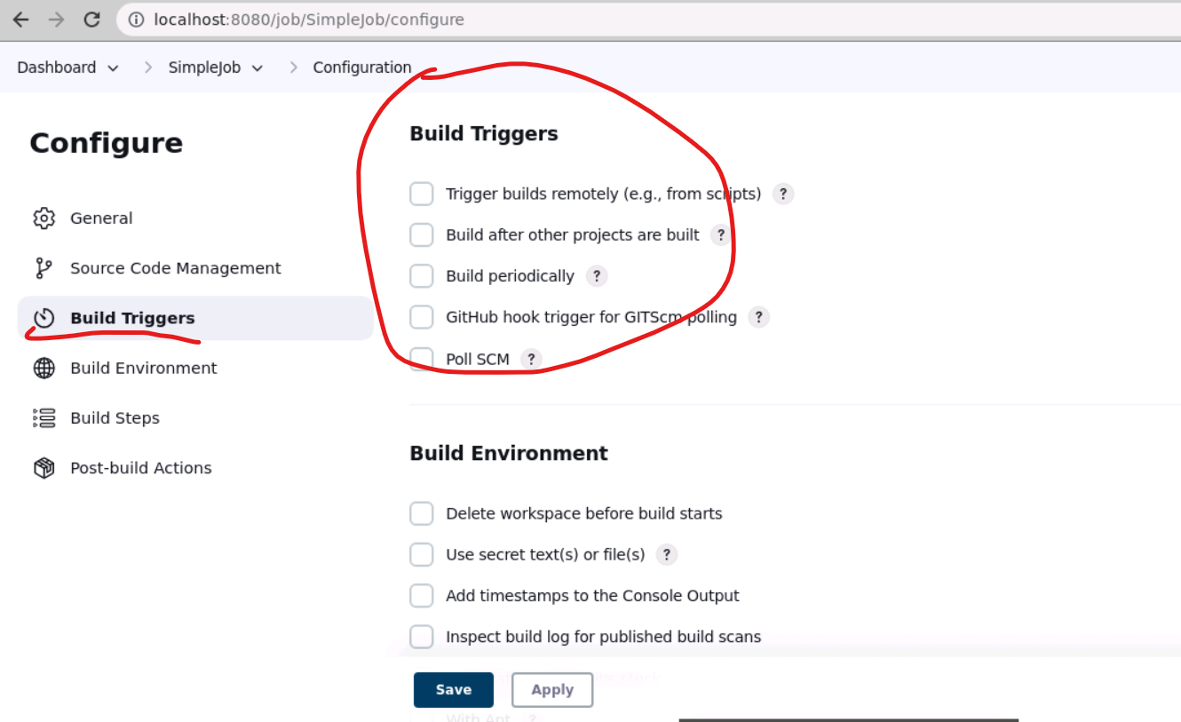
Build trigger this option we need to select if you want to do this task again and again.

Slide 11
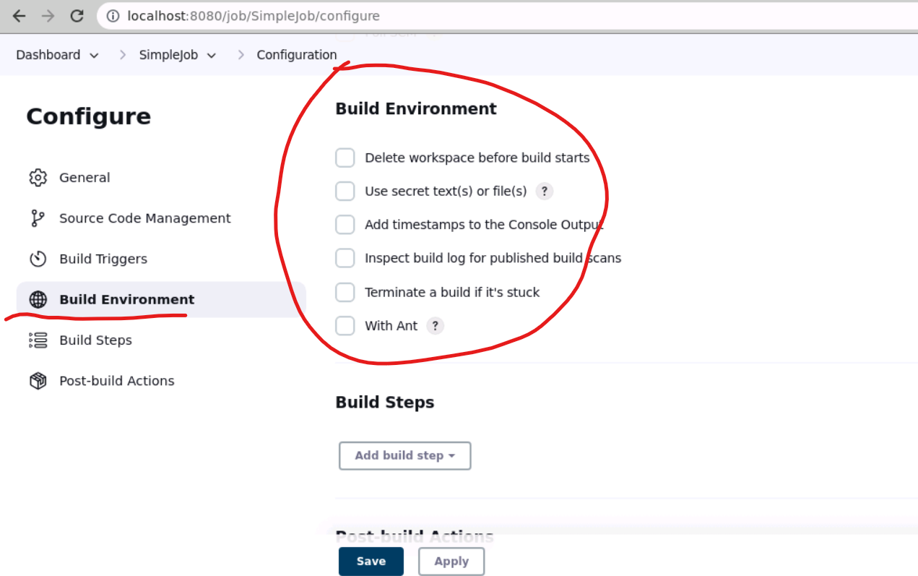
Build environment : before build you want to set any information then you need to selection this option

Slide 12
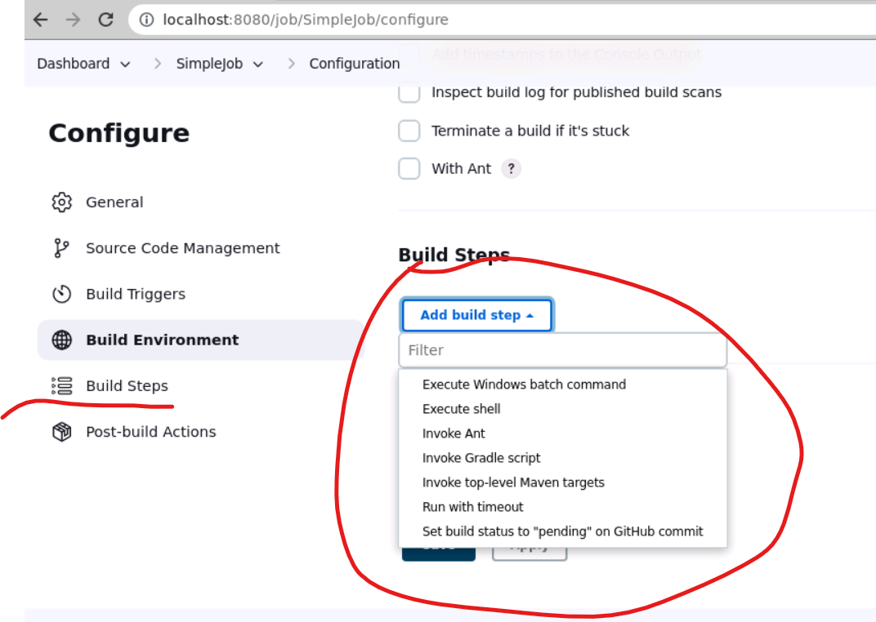
Build : in this option we need to write the command to build the project.

Slide 13
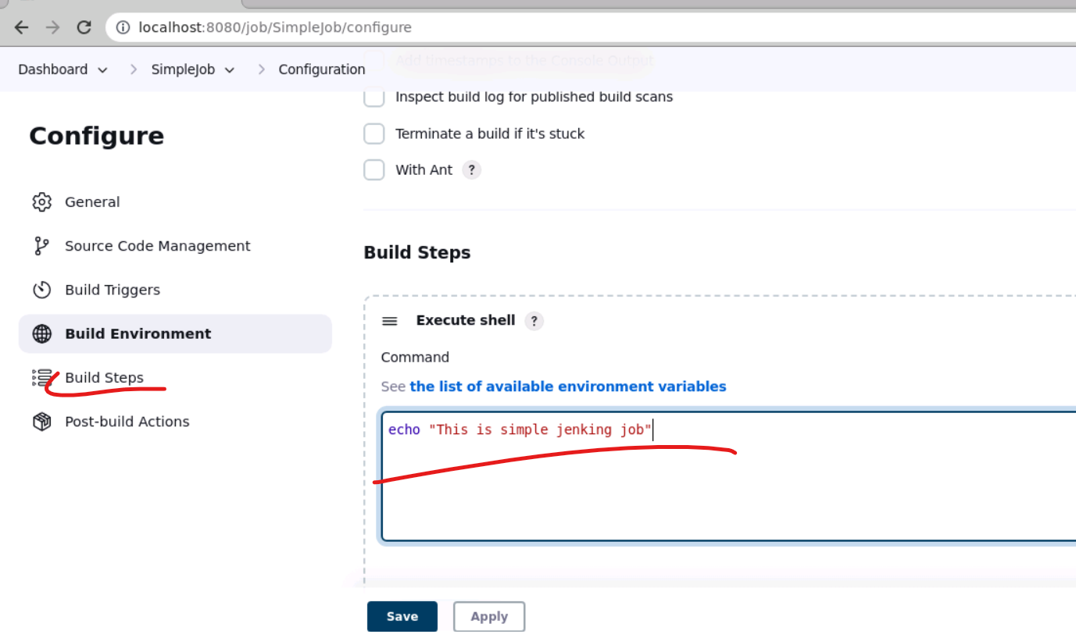
So in this job we are running simple echo message as a job through Jenkin.

Slide 14
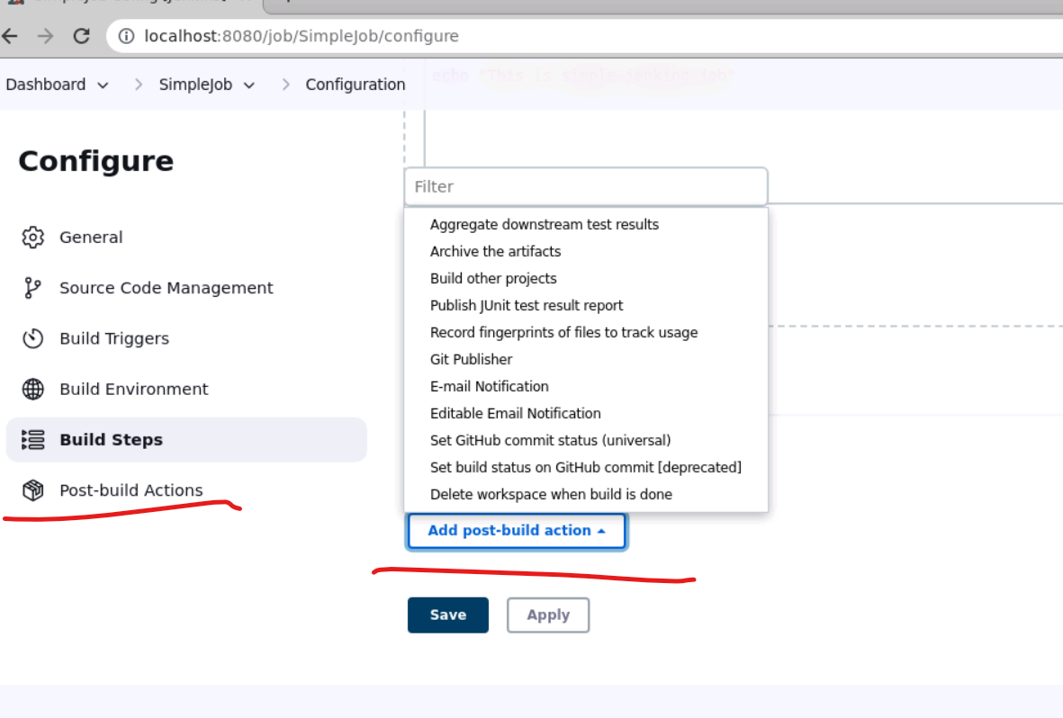
Post build : after post build if you want to do any task then we need to write the code here.

Slide 15
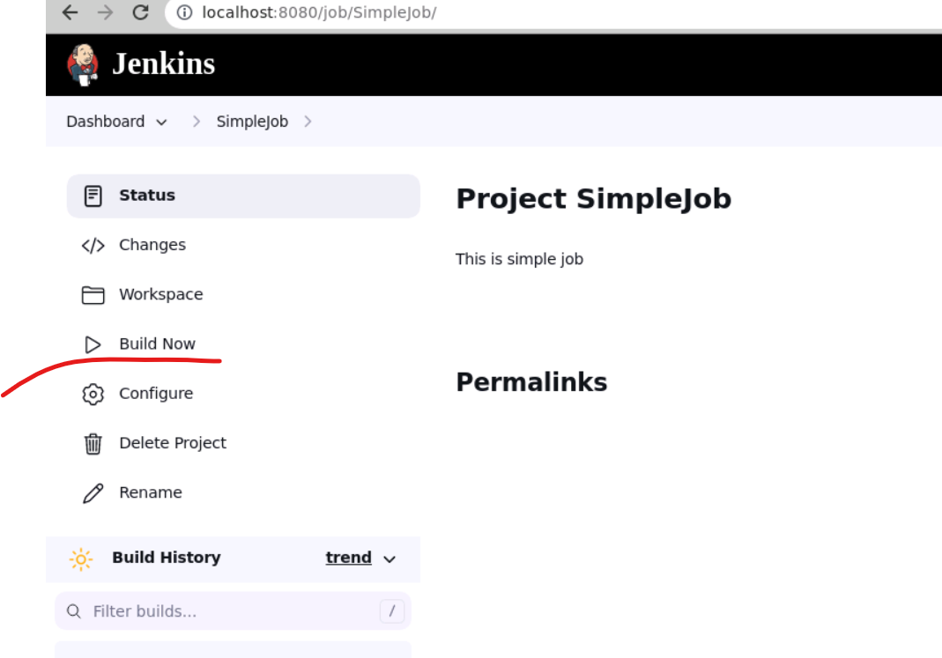
After save job then click build job now

Slide 16
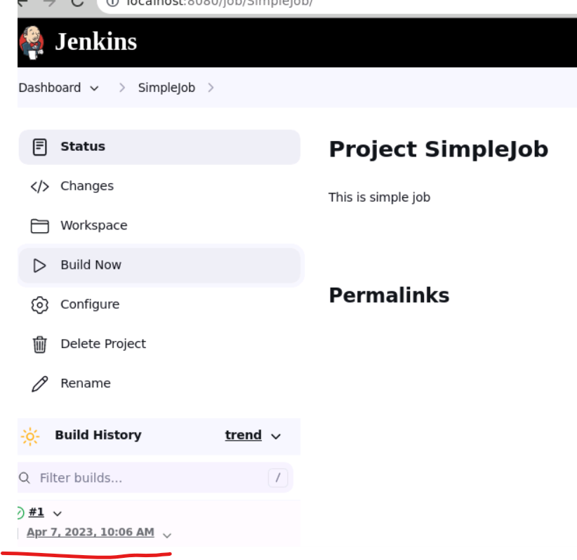
Now you can see the build status : if green color means success if red color means failure

Slide 17
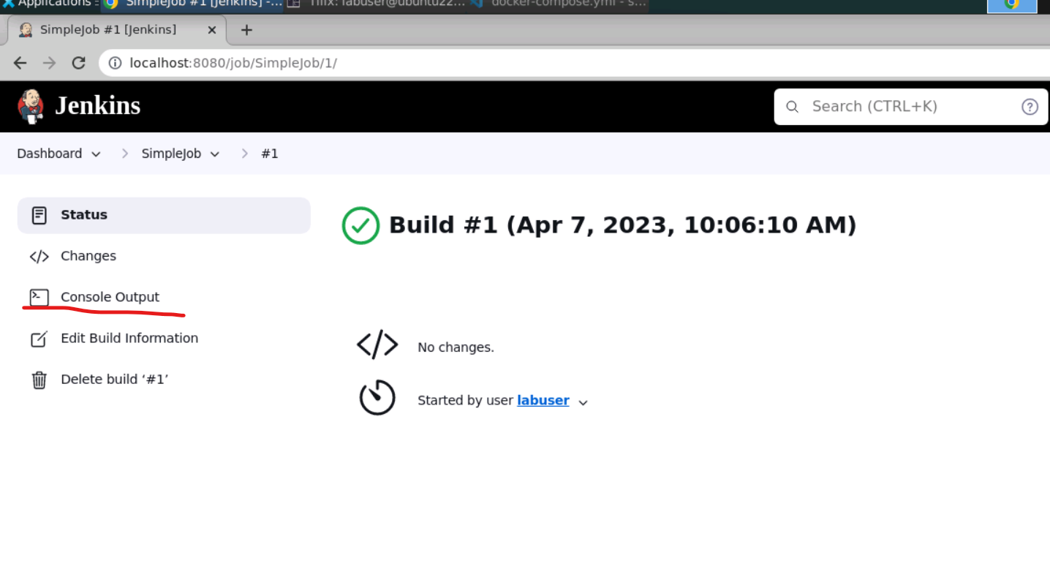
Now click on console output option

Slide 18
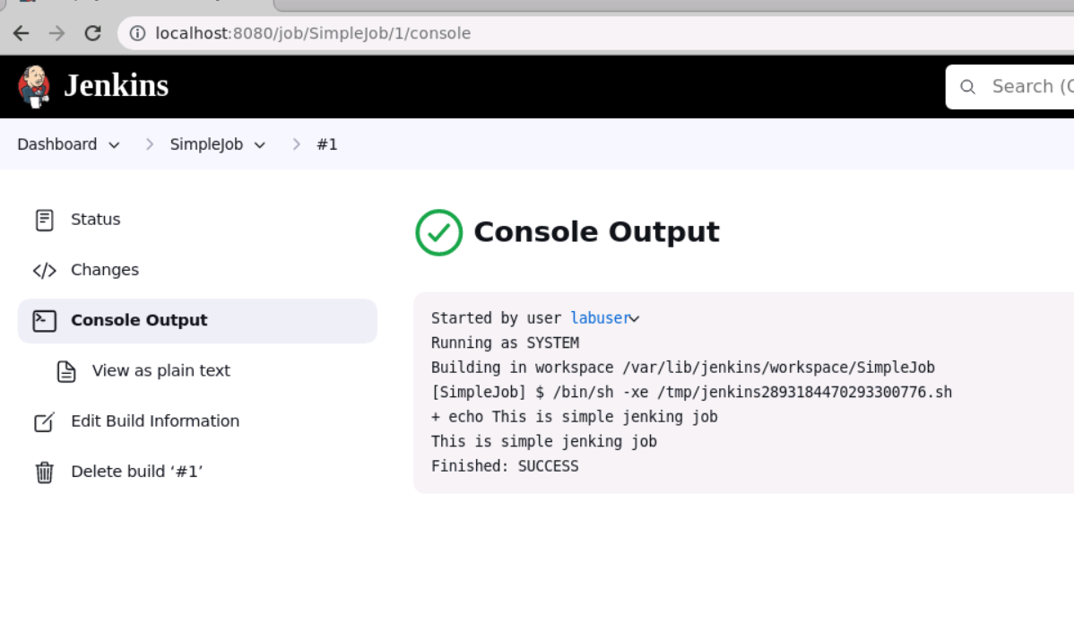
Now you can see the Jenkin executed job

